Slide 1
Lesson 4: String Handling Techniques
Mack 2023
Notes:
Last updated: 6/14/2023

Slide 2
Warm Up

Slide 3
Starter activity
Make a prediction
Questions .
What will be the output of print when this program is executed?
Python * 3
Python Python Python
PythonPythonPython
There is an error in the program because you cannot multiply a string
compare = "Python" * 3
print(compare)
1
2
▹
3
4
Why? .
You can multiply a string, it will concatenate the same value for the number of times stated.

Slide 4
Starter activity
Make a prediction
Questions .
What will be the output of print when this program is executed?
True
False
It is not possible to know the output without executing the program
There is an error in the program
compare = "Python" > "Java"
print(compare)
▹
1
2
3
4
Why? .
Imagine these words are in the dictionary. Java would appear before Python, this makes Python greater than Java.

Slide 5
Starter activity
Make a prediction
Questions .
What will be the output of print when this program is executed?
Python + Java
Python Java
PythonJava
There is an error in the program because you cannot add two string together
compare = "Python" + "Java"
print(compare)
1
2
▹
3
4
Why? .
The + sign concatenates (joins) the two string together. There is no space because it hasn’t been given that instruction.

Slide 6

Lesson 26: String handling I
Objectives
In this lesson, you will:
Describe the function of string operators
Use string-handling techniques
Use for loops with string operations

Slide 7
Activity 1

Slide 8
Performing operations with string
Activity 1
You can perform operations with string in a similar way to the operations that you can perform with numbers.
"Python" > "Java"
"Python" + "Java"
"Python" * 3

Slide 9
String handling
Activity 1
You can also use string-handling techniques to find out things about a string.
Question .
What do you think this program will output?
word = "python"
wordlength = len(word)
print(wordlength)
>>>
6

Slide 10
String handling
Activity 1
len() is used to count the number of characters in a string.
This would include spaces as well if they were present.
word = "python"
wordlength = len(word)
print(wordlength)
>>>
6

Slide 11
String handling
Activity 1
You can also use string handling to access a character of a string.
Question .
What do you think this program will output?
word = "python"
firstletter = word[0]
print(firstletter)
>>>
p

Slide 12
String handling
Activity 1
Each character on the string has an index number.
In Python, the index always starts at 0.
Question .
What would you need to write in order to access the t in python?
word = "python"
0 | 1 | 2 | 3 | 4 | 5
p | y | t | h | o | n
word[ ]
word[2]

Slide 13
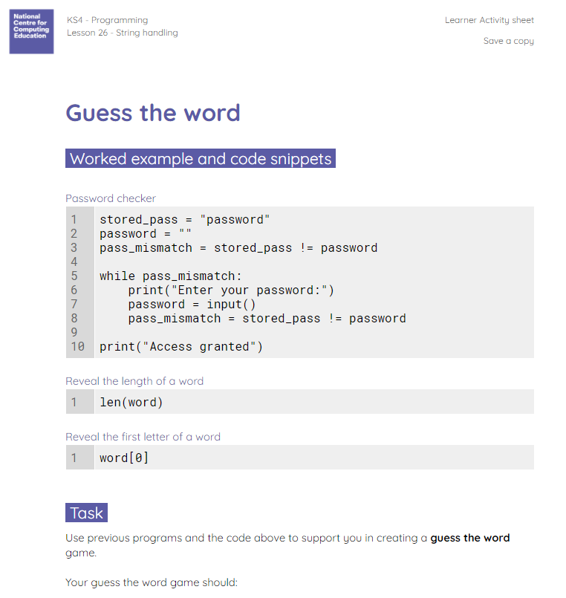
Create a program that uses these techniques
Activity 1
Use previous programs and the example code given to create a ‘guess the word’ game.
The worksheet should be used to help you complete this activity.

Slide 14
Guess the word game: example solution
Activity 1
word = "sandwich"
user_guess = ""
not_guessed = word != user_guess
guesses = 0
while not_guessed and guesses < 5:
if guesses == 1:
firstletter = word[0]
print(f"The first letter of the word is {firstletter}")
elif guesses == 3:
lastletter = word[7]
print(f"The last letter of the word is {lastletter}")
print("Guess the word:")
user_guess = input()
guesses = guesses + 1
not_guessed = word != user_guess
if word == user_guess:
print("Correct, you win!")
else:
print("Incorrect, you lose!")

Slide 15
Activity 2

Slide 16

Activity 2
For loops: iterating through a string
for in :
For loops are convenient for iterating over the characters of a string
variable
string
block of statements
Remember: For loops can be used for iterating over any sequence of elements, e.g. number sequence

Slide 17
Activity 2
Iterating over a word
1 2 3 4 | word = "sheep" for letter in word: print(letter)
Question .
What do you think will be displayed on the screen when this program is executed?
s
h
e
e
p

Slide 18
Activity 2
Iterating over a word
1 2 3 4 5 6 7 8 | word = "sheep" count_e = 0 for letter in word: if letter == "e": count_e = count_e + 1 print(count_e)
Question .
What do you think will be displayed on the screen when this program is executed?
2
The count variable is initialised to 0 and is incremented by 1 each time an e is found in the word.

Slide 19
Activity 2
Iterating over a word: walkthrough
1 2 3 4 5 6 7 8 | word = "sheep" count_e = 0 for letter in word: if letter == "e": count_e = count_e + 1 print(count_e)
State .
word
sheep

Slide 20
Activity 2
Iterating over a word: walkthrough
1 2 3 4 5 6 7 8 | word = "sheep" count_e = 0 for letter in word: if letter == "e": count_e = count_e + 1 print(count_e)
State .
word
sheep
count_e
0

Slide 21
Activity 2
Iterating over a word: walkthrough
1 2 3 4 5 6 7 8 | word = "sheep" count_e = 0 for letter in word: if letter == "e": count_e = count_e + 1 print(count_e)
State .
word
letter
sheep
s
count_e
0

Slide 22
Activity 2
Iterating over a word: walkthrough
1 2 3 4 5 6 7 8 | word = "sheep" count_e = 0 for letter in word: if letter == "e": count_e = count_e + 1 print(count_e)
State .
word
letter
False
sheep
s
count_e
0

Slide 23
Activity 2
Iterating over a word: walkthrough
1 2 3 4 5 6 7 8 | word = "sheep" count_e = 0 for letter in word: if letter == "e": count_e = count_e + 1 print(count_e)
State .
word
letter
False
sheep
s
count_e
0

Slide 24
Activity 2
Iterating over a word: walkthrough
1 2 3 4 5 6 7 8 | word = "sheep" count_e = 0 for letter in word: if letter == "e": count_e = count_e + 1 print(count_e)
State .
word
letter
sheep
h
count_e
0

Slide 25
Activity 2
Iterating over a word: walkthrough
1 2 3 4 5 6 7 8 | word = "sheep" count_e = 0 for letter in word: if letter == "e": count_e = count_e + 1 print(count_e)
State .
word
letter
False
sheep
h
count_e
0

Slide 26
Activity 2
Iterating over a word: walkthrough
1 2 3 4 5 6 7 8 | word = "sheep" count_e = 0 for letter in word: if letter == "e": count_e = count_e + 1 print(count_e)
State .
word
letter
False
sheep
h
count_e
0

Slide 27
Activity 2
Iterating over a word: walkthrough
1 2 3 4 5 6 7 8 | word = "sheep" count_e = 0 for letter in word: if letter == "e": count_e = count_e + 1 print(count_e)
State .
word
letter
sheep
e
count_e
0

Slide 28
Activity 2
Iterating over a word: walkthrough
1 2 3 4 5 6 7 8 | word = "sheep" count_e = 0 for letter in word: if letter == "e": count_e = count_e + 1 print(count_e)
State .
word
letter
True
sheep
e
count_e
0

Slide 29
Activity 2
Iterating over a word: walkthrough
1 2 3 4 5 6 7 8 | word = "sheep" count_e = 0 for letter in word: if letter == "e": count_e = count_e + 1 print(count_e)
State .
word
letter
sheep
e
count_e
1

Slide 30
Activity 2
Iterating over a word: walkthrough
1 2 3 4 5 6 7 8 | word = "sheep" count_e = 0 for letter in word: if letter == "e": count_e = count_e + 1 print(count_e)
State .
word
letter
sheep
e
count_e
1

Slide 31
Activity 2
Iterating over a word: walkthrough
1 2 3 4 5 6 7 8 | word = "sheep" count_e = 0 for letter in word: if letter == "e": count_e = count_e + 1 print(count_e)
State .
word
letter
True
sheep
e
count_e
1

Slide 32
Activity 2
Iterating over a word: walkthrough
1 2 3 4 5 6 7 8 | word = "sheep" count_e = 0 for letter in word: if letter == "e": count_e = count_e + 1 print(count_e)
State .
word
letter
sheep
e
count_e
2

Slide 33
Activity 2
Iterating over a word: walkthrough
1 2 3 4 5 6 7 8 | word = "sheep" count_e = 0 for letter in word: if letter == "e": count_e = count_e + 1 print(count_e)
State .
word
letter
sheep
p
count_e
2

Slide 34
Activity 2
Iterating over a word: walkthrough
1 2 3 4 5 6 7 8 | word = "sheep" count_e = 0 for letter in word: if letter == "e": count_e = count_e + 1 print(count_e)
State .
word
letter
False
sheep
p
count_e
2

Slide 35
Activity 2
Iterating over a word: walkthrough
1 2 3 4 5 6 7 8 | word = "sheep" count_e = 0 for letter in word: if letter == "e": count_e = count_e + 1 print(count_e)
State .
word
letter
False
sheep
p
count_e
2

Slide 36
Activity 2
Iterating over a word: walkthrough
1 2 3 4 5 6 7 8 | word = "sheep" count_e = 0 for letter in word: if letter == "e": count_e = count_e + 1 print(count_e)
State .
word
letter
sheep
p
count_e
2

Slide 37
Activity 2
Iterating over a word: walkthrough
1 2 3 4 5 6 7 8 | word = "sheep" count_e = 0 for letter in word: if letter == "e": count_e = count_e + 1 print(count_e)
State .
word
letter
sheep
p
count_e
2

Slide 38
Activity 3

Slide 39
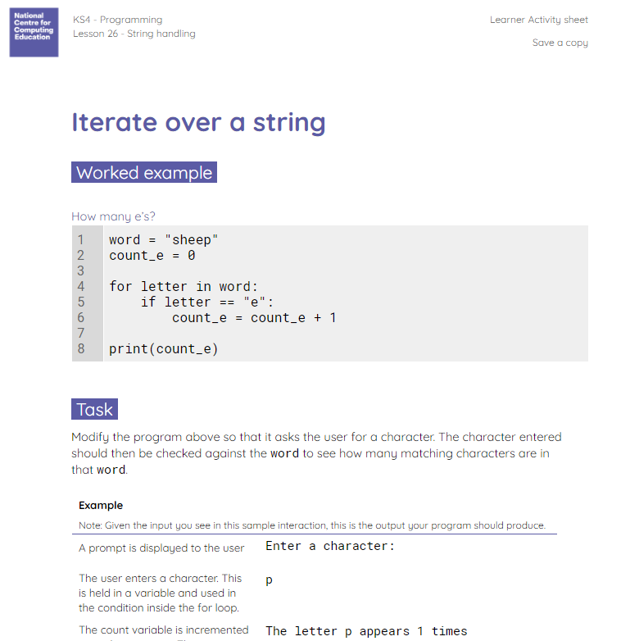
Iterate over a string
Activity 3
Use the worksheet to modify the program used in the last activity.
You should then incorporate this code into your ‘guess the word’ game.

Slide 40
Iterate over a string: modified code
Activity 3
word = "sheep"
count = 0
print("Enter a character:")
character = input()
for letter in word:
if letter == character:
count = count + 1
print(f"The letter {character} appears {count} times")

Slide 41
Activity 4

Slide 42
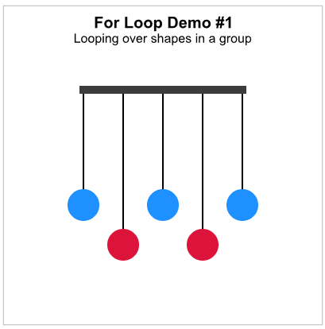
Looping Through Group Children
Activity 4
In this section, we will learn an important new concept: how to loop. That is, how to run the same piece of code repeatedly. This is a very important idea that you will use heavily from now on in your coding! Read the Looping through Group Children!

Slide 43
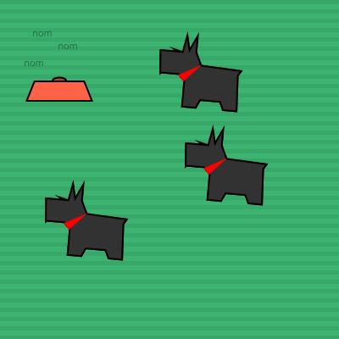
Looping Through Group Children
Activity 4
Complete 3pts of exercises!

Slide 44
Wrap Up

Slide 45
Python documentation
Wrap Up
Open the Python documentation using the provided link.
Discover what the following string methods do:
str.capitalize()
str.title()
str.swapcase()
ncce.io/stringmethods

Slide 46
Python documentation
Wrap Up
str.capitalize()
Returns a string with the first character capitalised.
str.title()
Returns a string with the first letter of each word capitalised.
str.swapcase()
Swaps the case, e.g. lower case becomes upper case.

Slide 47
Next lesson
Summary
In this lesson, you…
Learnt how to find the length of a string
Learnt how to access a character in a string
Learnt how to iterate over a string
Next lesson, you will…
Learn some further string-handling techniques
Complete a programming challenging based around string handling

